Slide 1
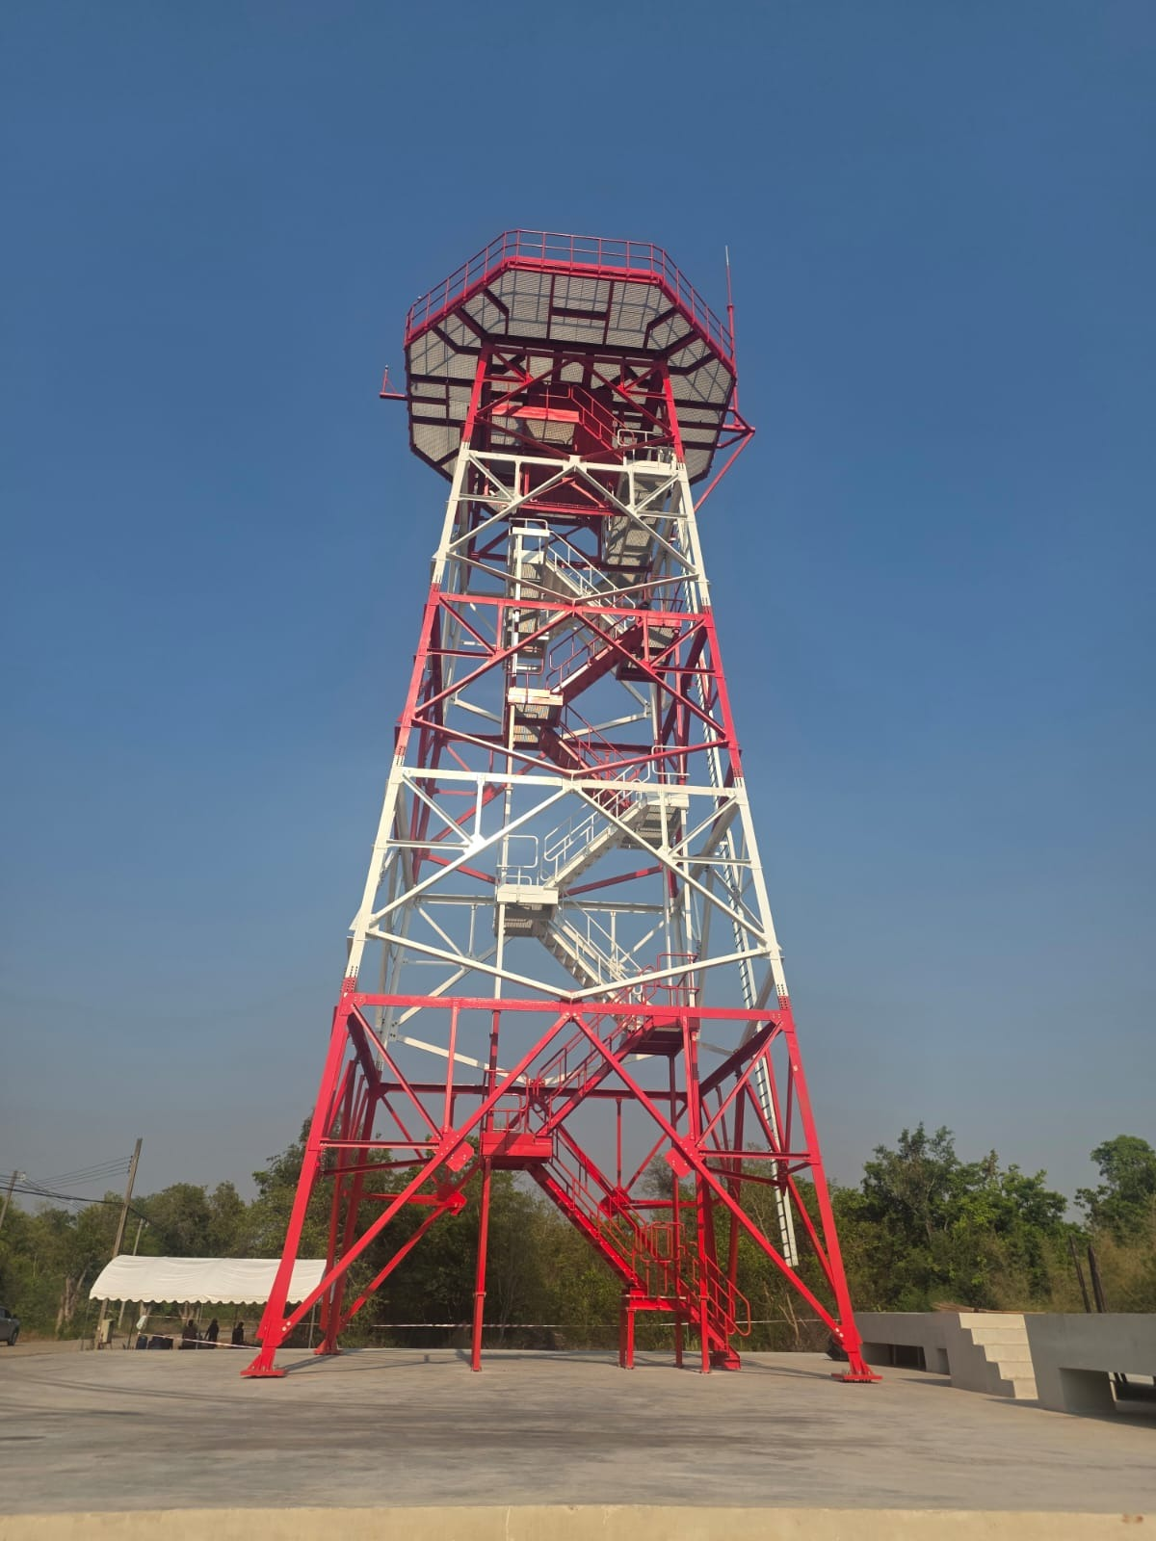
Naresh & Co
Telecommunication Infrastructure Solutions
Telecom Infrastructure Fabricating | End-to-End Wireless & Wireline Network Solutions
2G/3G/4G/5G | Latice Tower Construction and Fabrication up to 100 Meters
ISO 9001:2015 Certified | Pan India & International
20+
4+
100m
Global
Years Experience
Major Clients
Tower Height
Reach
Company Profile · Confidential

Slide 2
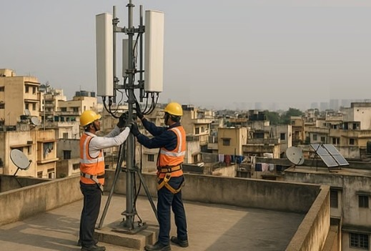
Naresh & Co
Telecommunication Infrastructure Solutions
About Naresh & Co
ISO 9001:2015
Who We Are
CERTIFIED
Quality Management Standards
Naresh & Co is a leading provider of end-to-end engineering solutions for the telecommunication sector, specializing in construction, installation and commissioning of wireless and wireline telecom equipment and networks across India and internationally.
International Operations
Successfully completed major telecom projects in Thailand and overseas — world-class global delivery.
Our portfolio spans supply and fabrication of telecommunications and EB mast, poles and towers; IBS Poles, Micro Towers (up to 12 m), Macro Towers (up to 100 m — GPT and RTT), and full deployment of 2G, 3G, 4G, 5G, MW, and Microwave hops.
Our Commitment
Manufacturing Excellence
We invest in tools and training on the latest technologies, enabling our expert team to execute projects with maximum efficiency and deliver customized solutions for even the most demanding telecom challenges.
In-house EB cement poles manufacturing ensures quality control and timely delivery.
Pan India Operations
Executing Bharti Airtel projects across multiple states and cities throughout India.
718/3, T.H Road, Thiruvottiyur, Chennai 600019 | +91 98840 56221 | nareshandco@yahoo.com
Page 2

Slide 3
Naresh & Co
Telecommunication Infrastructure Solutions
Our Services
Comprehensive end-to-end solutions for the full telecom infrastructure lifecycle.
Telecom Infrastructure
Transmission & Distribution
Inspection Services
Network Deployment
Site survey, foundation works, tower erection, GSM/CDMA BTS I&C, microwave hops alignment.
Line surveys, route alignment, earthing & erection, conductor stringing, OPGW, commissioning.
Inspection of towers, conductors, OPGW, hardware, earthing materials and site auditing.
2G/3G/4G/5G, MW, WIFI, IWAN, FTTH, FTTB design, installation, configuration, commissioning.
Wire Line Services
Project Management
EB Cement Poles Mfg
Cable Trays & Clamps
MSAN, Switches, MUX, Routers I&C. OFC & Copper network, voice/DSL migration, MDF termination.
End-to-end PM: design, scheduling, procurement, QA, OHSE compliance, statutory clearances.
In-house precision-engineered poles with strict quality control to meet all industry standards.
Supply of GI/SS cable trays, ladder trays, U-bolts, clamps and all associated accessories.
718/3, T.H Road, Thiruvottiyur, Chennai 600019 | +91 98840 56221 | nareshandco@yahoo.com
Page 3

Slide 4
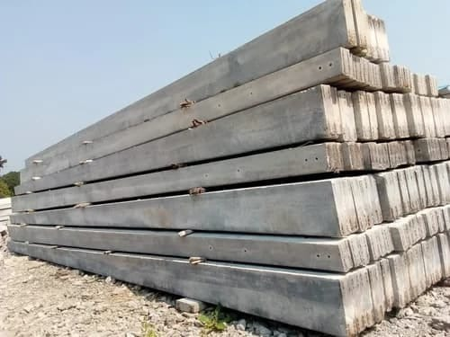
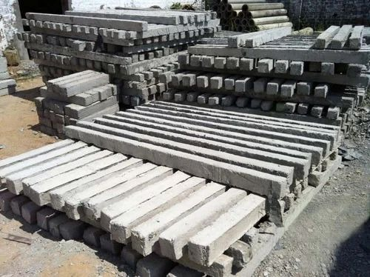
Naresh & Co
Telecommunication Infrastructure Solutions
EB Cement Poles & Panel Boards
In-House Manufacturing
Superior compressive strength and durability
Precision-engineered taper and cross-section
Strict quality control at every production stage
Manufactured to IS and telecom industry standards
Delivered ready-to-install at project sites
Cost-effective vs. third-party procurement
EB Panel Boards
Supply & Installation
Main & sub-distribution boards (MDB/SDB)
MCB, MCCB, RCCB and isolator assemblies
Bus bar trunking and cable termination
Meter panels and energy measurement systems
Compliant with IS 8623 and IEC 61439 standards
718/3, T.H Road, Thiruvottiyur, Chennai 600019 | +91 98840 56221 | nareshandco@yahoo.com
Page 4

Slide 5
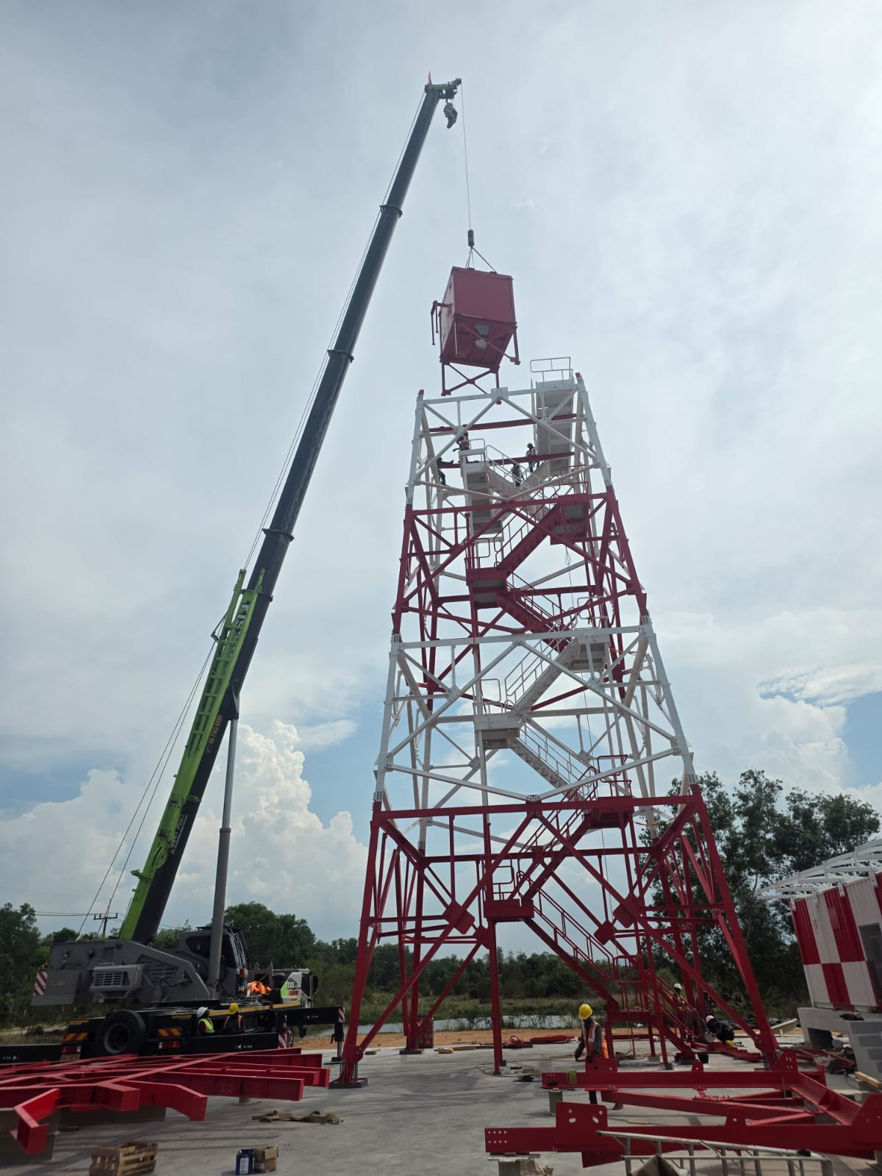
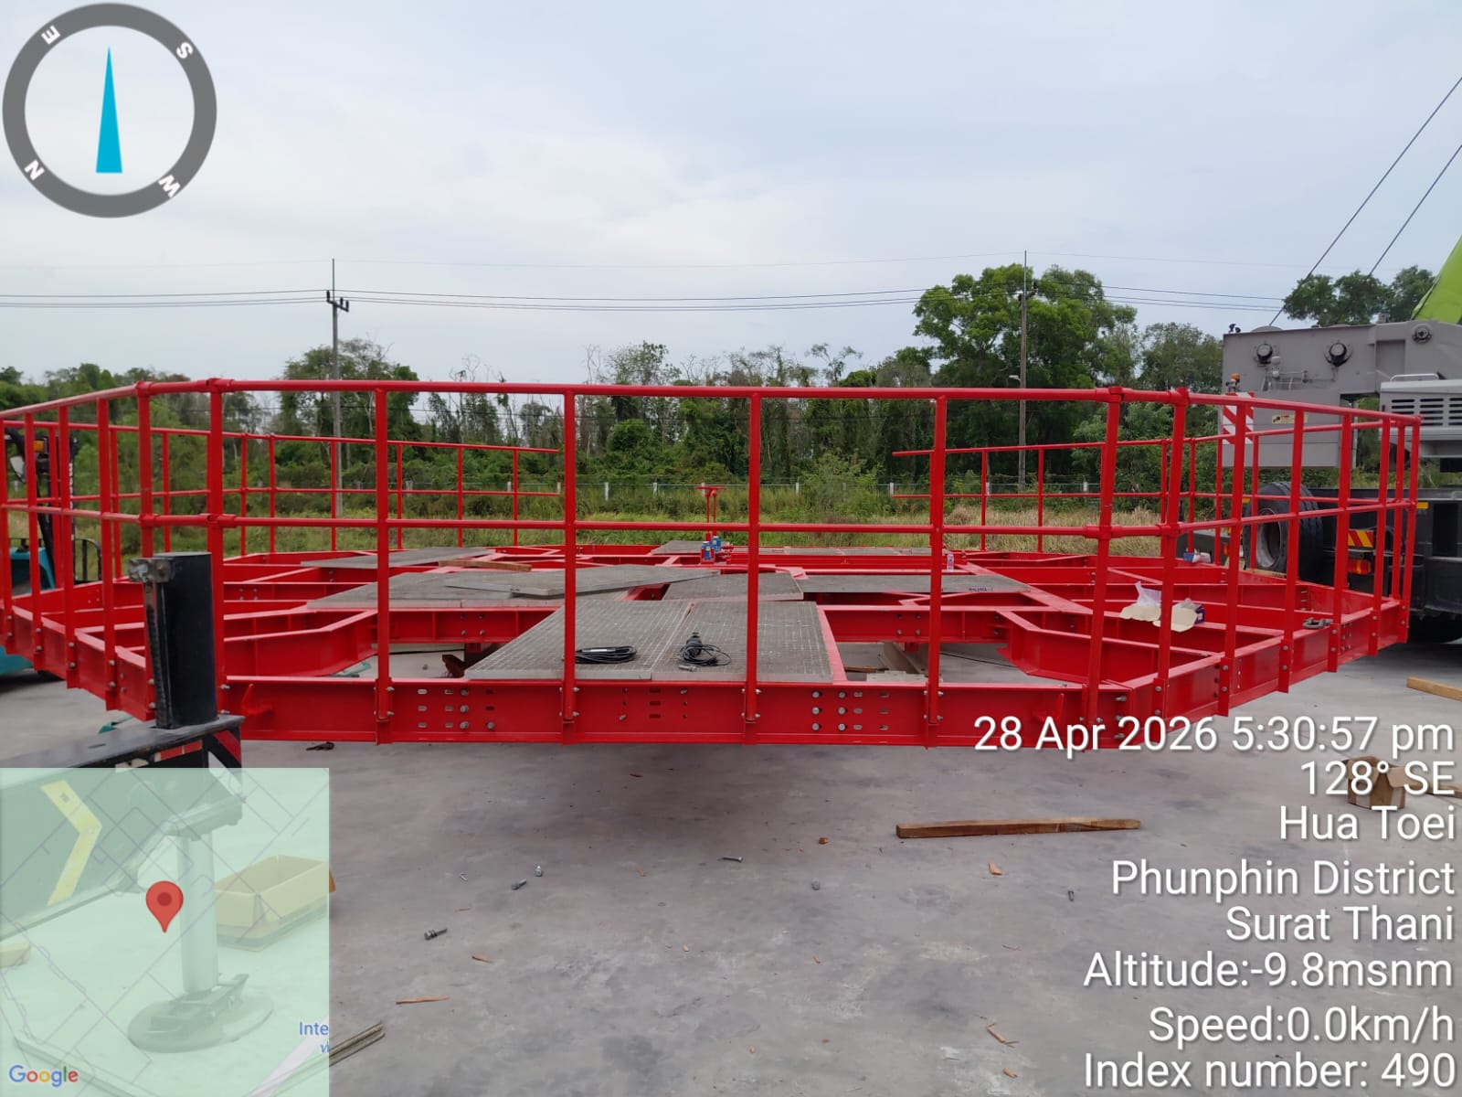
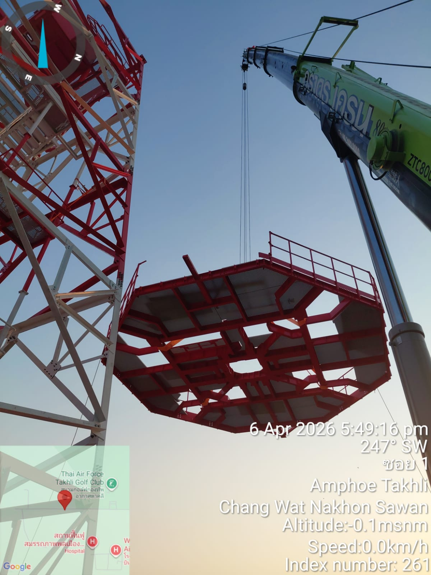
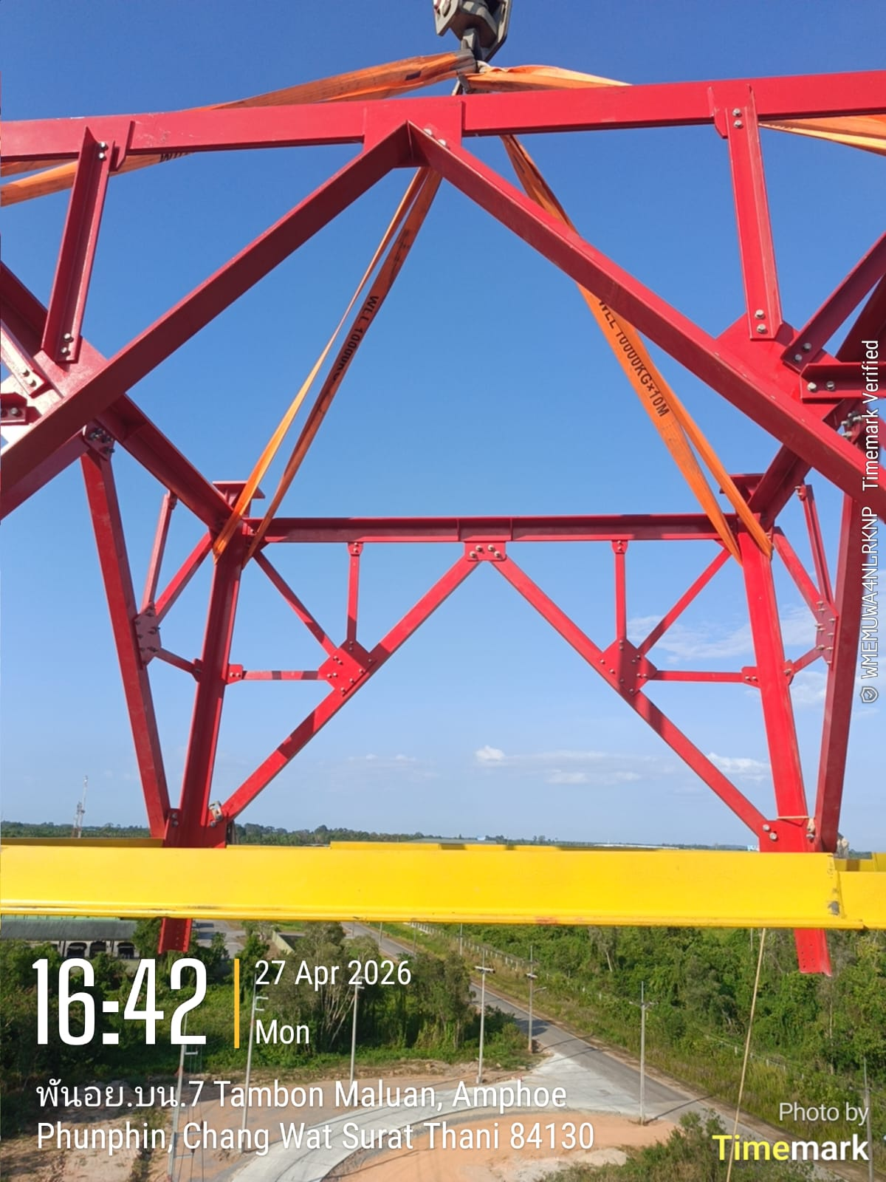
Naresh & Co
Telecommunication Infrastructure Solutions
Tower Infrastructure Showcase
Thailand Telecom Site Construction and Tower Erection
718/3, T.H Road, Thiruvottiyur, Chennai 600019 | +91 98840 56221 | nareshandco@yahoo.com
Page 4

Slide 6
Naresh & Co
Telecommunication Infrastructure Solutions
Cable Trays, Clamps & Safety Measures
Cable Trays & Clamps Supply
Perforated Cable Trays
Ladder Cable Trays
Clamps & Accessories
GI and SS perforated trays for organized cable routing in towers, shelters and equipment rooms. Widths 100–600mm.
Heavy-duty ladder trays for large cable bundles. Hot-dip galvanized for outdoor and harsh environments.
U-bolts, J-bolts, hanger clamps, saddle clamps, cable ties — zinc-plated or SS for corrosion resistance.
PPE Requirements
Site Protocols
Emergency & Environment
Zero Accident Policy
Safety helmets, full-body harnesses, safety footwear, high-visibility vests, eye and ear protection — mandatory on all sites.
Daily toolbox talk, risk assessment & method statement (RAMS), permit-to-work (PTW), scaffolding and fall-arrest inspection.
First-aid trained personnel, evacuation plan, fire extinguishers, waste segregation, hazardous material handling protocols.
100% PPE compliance, daily safety audits and incident reporting to maintain our zero-accident commitment.
ISO 9001:2015 | OHSE Certified
718/3, T.H Road, Thiruvottiyur, Chennai 600019 | +91 98840 56221 | nareshandco@yahoo.com
Page 5

Slide 7
Naresh & Co
Telecommunication Infrastructure Solutions
Our Capabilities
Professional Services
Construction Expertise
Project Management
Technical Specializations
Pre-installation site readiness survey
Cellular tower construction — all equipment
Planning & scheduling per roll-out schedule
Microwave installation, testing, relocation
Equipment installation and commissioning
Rooftop, in-building, ground-based sites
Risk management and materials ordering
Transmission line testing & optimization
HW & SW upgrades (all configurations)
Complete electrical circuit distribution
Health & safety compliance and QA
WIFI coverage predictions & frequency planning
Call testing including E911 verification
Greenfield sites in all terrains and soils
Documentation and milestone reporting
CAT 6 cable supply, laying and termination
Site and network monitoring
Tower unloading, assembly and erection
Cost control and progress reporting
Post-commissioning walk testing
Emergency and on-call work support
Scheduled maintenance and emergency repair
Inventory management and coordination
RF optimization — cluster testing (ATP)
718/3, T.H Road, Thiruvottiyur, Chennai 600019 | +91 98840 56221 | nareshandco@yahoo.com
Page 6

Slide 8
Naresh & Co
Telecommunication Infrastructure Solutions
Our Valued Customers
Bharti Airtel Ltd
Pan India
I&C of IBS for Chennai and multiple cities. Micro Sites deployment, Pole erection, civil works, electrical works, Equipment I&C, Site Survey, Test Drive and IWAN implementation nationwide.
Huawei Telecommunications India Pvt Ltd
3G/4G/MW
3G/4G Installation and Commissioning, Integration, MW I&C, Traffic Migration, MSAN Equipment Installation and Live Traffic Migration.
Tech Mahindra Ltd
WIFI
WIFI Design and Deployment services across multiple locations throughout India.
Data Dimension
Networking
Cisco MUX installation and commissioning services.
WHY CHOOSE NARESH & CO
✓ ISO 9001:2015 Certified
✓ Pan India Operations
✓ International Reach
✓ In-House Manufacturing
✓ 55m Tower Expertise
✓ End-to-End Solutions
718/3, T.H Road, Thiruvottiyur, Chennai 600019 | +91 98840 56221 | nareshandco@yahoo.com
Page 7

Slide 9
CONTACT US
Quick Facts
Get in touch for your telecom infrastructure needs
Email
GST
33ANLPS8411K2ZL
nareshandco@yahoo.com
sivam@nareshandco.co.in
Website
www.nareshandco.co.in
muthazhagupandian@nareshandco.co.in
Certification
ISO 9001:2015
Phone
+91 98840 56221
Operations
Pan India + International
+91 72990 25588
044 – 25726411
Sivam (Director)
Max Tower
100 Metres
Address
City
Chennai, Tamil Nadu
718/3, T.H Road
Thiruvottiyur, Chennai 600019
Tamil Nadu, India
© 2026 Naresh & Co. All rights reserved. | ISO 9001:2015 Certified

